Slide 1




Coherence and Salience-Based Multi-Document
Relationship Mining
Yongpan Sheng
University of Electronic Science and Technology of China
Our research group: Statistical Machine Intelligence & LEarning (SMILE Lab), http://smilelab.uestc.edu.cn

Slide 2
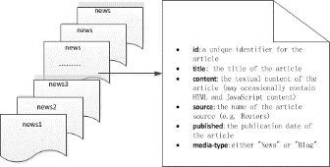



Motivation
In today’s interconnected world, there is an endless 24/7 stream of new articles appearing online. Faced with these overwhelming amounts of data, it is often helpful to consider only the key entities and concepts and their relationships.
This is challenging, as relevant connections may be spread across a number of disparate articles and sources.
article
article
article
?
A fixed topic
Explore
messy,
unstructured data
article
article
Our research group: Statistical Machine Intelligence & LEarning (SMILE Lab), http://smilelab.uestc.edu.cn

Slide 3

Problem Formulation
Our task is aimed to assist users in quickly finding salient connections and facts from a collection of relevant articles, and in summary, it can be best described as a combination of three major subtasks:
Subtask 1: Candidate Fact Extraction
Given a collection of documents clustered around a topic . The goal of this
subtask is to extract a set of facts from . Each of facts is essentially triple,
for subject ，relation , and object . Since we need to estimate the coherence of these
preferred facts for , we refer to them as candidate facts.
Subtask 2: Topic Coherence Estimation of Candidate Facts
Given a specified document topic , the goal of the subtask is to find a subset of , and
each of them should be coherent with .
Subtask 3: Conceptual Graph Construction
The goal of the subtask is to determine which of the facts from generated by the
previous subtask are more likely to be salient, which of their entities and concepts to merge
and, when merging, which of the available labels to leverage in the final conceptual graph .
Our research group: Statistical Machine Intelligence & LEarning (SMILE Lab), http://smilelab.uestc.edu.cn

Slide 4
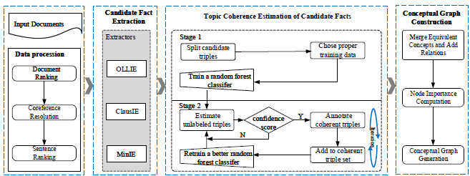
The Framework of Our Approach
Data procession
Candidate Fact Extraction
Conceptual Graph Construction
Topic Coherence Estimation of Candidate Facts
Our research group: Statistical Machine Intelligence & LEarning (SMILE Lab), http://smilelab.uestc.edu.cn

Slide 5
The Framework of Our Approach
Document Ranking
Select the words appearing in its relevant document collection with sufficiently high frequency as topic words. Next, we rank the document by the TF-IDF weights of the topic words in each document, and by default, to obtain a final ranked top-k document list.
Data procession
Coreference Resolution
Pronouns and other form of coreference are resolved in each document using Stanford CoreNLP system. E.g., “she” may be replaced by “Angela Merkel”).
Sentence Ranking
Computes the TextRank importance scores for all sentences. It then considers only those sentences with sufficiently high scores.
Our research group: Statistical Machine Intelligence & LEarning (SMILE Lab), http://smilelab.uestc.edu.cn

Slide 6
The Proposed Approach
Candidate Fact Extraction
Open IE extractors
predicate
OLLIE
predicate
Unstructured Text
ClausIE
MinIE
object
subject
object
Criteria: A Correct triple
As for a triple extracted by OLLIE, ClausIE, and MinIE, only when its confidence is greater
than 0.85 can it be judged that the triple is a correct extraction.
Our research group: Statistical Machine Intelligence & LEarning (SMILE Lab), http://smilelab.uestc.edu.cn

Slide 7
The Proposed Approach
Candidate Fact Extraction
predicate
Open IE extractors
Unstructured Text
OLLIE
predicate
ClausIE
object
MinIE
subject
object
Two categories of errors are due to: The extractors we chose are based on the dependency parsing
Trees
- Wrong boundaries, especially when triples with conjunctions in the sentence were not properly
segmented, which the Open IE approach sometimes fails to do.
- Uninformative extraction
i) occur in the relation phrases. i.e., the relation phrases are expressed by a combination product
of a verb with a noun, e.g., light verb constructions.
ii) the distance between the adjacent words in the relation phrase may, in fact, be distant in the
original sentence. e. g., we may obtain a triple of (“The police”, “are driving away”, “paraders”)
From such a sentence “The police are driving paraders away from GOP front-runner Trump”.
Our research group: Statistical Machine Intelligence & LEarning (SMILE Lab), http://smilelab.uestc.edu.cn

Slide 8
The Proposed Approach
Candidate Fact Extraction
Two categories of errors are due to: The extractors we chose are based on the dependency parsing
Trees
Wrong boundaries
Uninformative extraction
A few straightforward transformations to correct above errors:
We broke down triples with conjunctions in either of the noun phrase into separate triple
per conjunction.
We defined some word order constraints, i.e., the noun phrases in a triple (noun phrase1,
relation phrase, noun phrase2) are ordered. All words in noun phrase1 must appear before all words in relation phrase. All the words contained in noun phrase2 must appear after the predicate phrase.
Once above extracting process is completed, the framework will yield numerous candidate
triples . However, not all the triple is indicative of what is genuinely being expressed in a given text for the specified topic. E.g, the triple (“Trump”, “will visit”, “the Apple Inc”), this is a correct one but meaningless for the news topic like US president election.
Our research group: Statistical Machine Intelligence & LEarning (SMILE Lab), http://smilelab.uestc.edu.cn

Slide 9
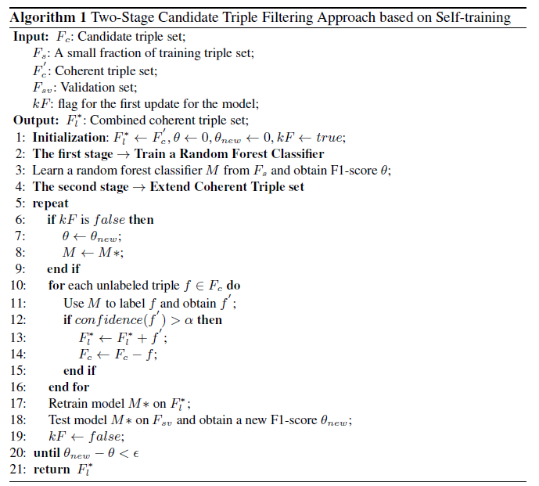
The Proposed Approach
Topic Coherence Estimation of Candidate Facts
Our research group: Statistical Machine Intelligence & LEarning (SMILE Lab), http://smilelab.uestc.edu.cn

Slide 10
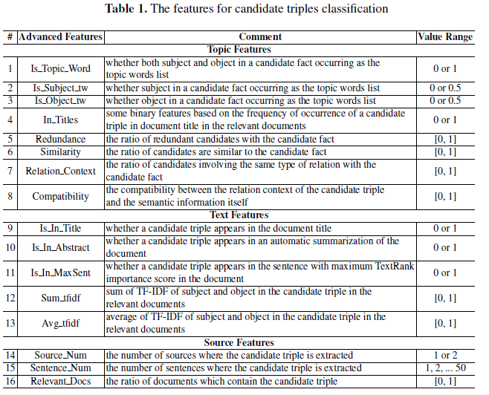
The Proposed Approach
Our research group: Statistical Machine Intelligence & LEarning (SMILE Lab), http://smilelab.uestc.edu.cn

Slide 11

The Proposed Approach
Conceptual Graph Construction
Merge Equivalent Concepts and Add Relations
- Make use of Stanford CoreNLP entity linker for identifying entity or concept mentions and link
them to Ontological KBs such as Wikipedia, Freebase entity linking.
- Rely on human-crafted knowledge
Node Importance Computation
We extended TextRank by introducing a new measure called “back probability” .
Conceptual Graph Generation
A heuristic to find a full graph that is connected and satisfies the size limit of 25 concepts.
Our research group: Statistical Machine Intelligence & LEarning (SMILE Lab), http://smilelab.uestc.edu.cn

Slide 12
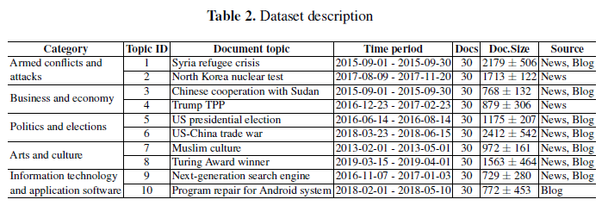
Experiment
Dataset
Our research group: Statistical Machine Intelligence & LEarning (SMILE Lab), http://smilelab.uestc.edu.cn

Slide 13
Experiment
Experimental setting
Sentence-level extractions
We first randomly sample 10 documents from every document topics (100 documents in total)
and perform coreference resolution. Then, once again a random sample of 10 sentences from
every extracted document (1,000 sentences in total) for further analysis. Each sentence is
examined by three expert annotators with NLP background independently to annotate all of
correct triples13
An empirical study
- coverage rate of topic entities and concepts
- confidence score
- compatibility of involved facts
Our research group: Statistical Machine Intelligence & LEarning (SMILE Lab), http://smilelab.uestc.edu.cn

Slide 14



Experiment
Experimental setting
Open IE Baseline Methods
- OLLIE
- ClausIE
- MinIE
- OpenIE-4.x
- Variants of our approach (without coreference)
- Variants of our approach (without transformation)
Evaluation Metrics
- Three standard metrics are Precision (P), Recall (R), F-score (F1), respectively
- The coverage rate of topic entities and concepts, i.e.,
- Confidence scores, i.e.,
The confidence value computed
by extraction system itself
Our research group: Statistical Machine Intelligence & LEarning (SMILE Lab), http://smilelab.uestc.edu.cn

Slide 15

Experiment
Experimental setting
Evaluation Metrics
- Compatibility of involved facts in the graph, i.e.,
where
Our research group: Statistical Machine Intelligence & LEarning (SMILE Lab), http://smilelab.uestc.edu.cn

Slide 16
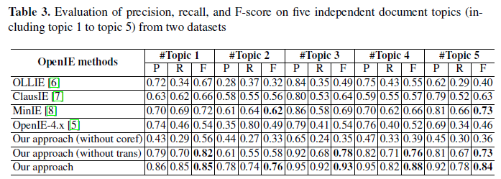
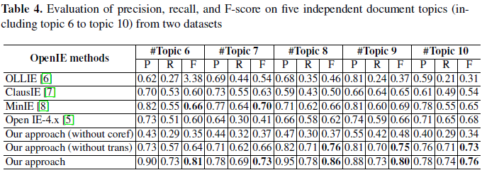
Experiment
Evaluation and Results Analysis
Performance Analysis of Extraction Approaches
Our research group: Statistical Machine Intelligence & LEarning (SMILE Lab), http://smilelab.uestc.edu.cn

Slide 17
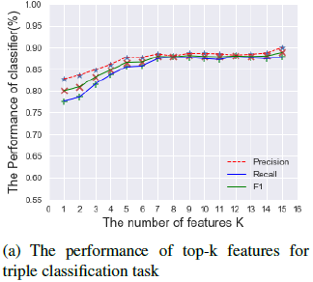
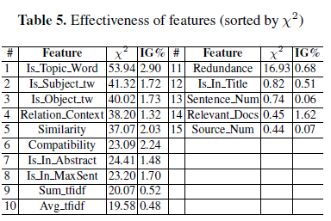
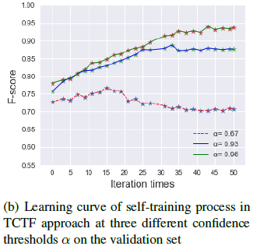
Experiment
Evaluation and Results Analysis
Feature Selection and Parameter Tuning
Our research group: Statistical Machine Intelligence & LEarning (SMILE Lab), http://smilelab.uestc.edu.cn

Slide 18
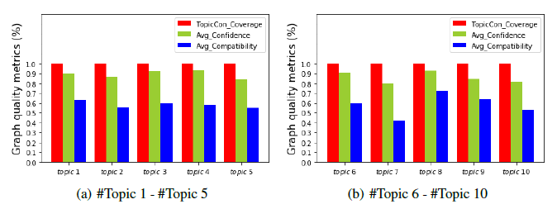
Experiment
Quality Analysis of Conceptual Graph
100%
87%
58%
Our research group: Statistical Machine Intelligence & LEarning (SMILE Lab), http://smilelab.uestc.edu.cn

Slide 19
Thank you
Our research group: Statistical Machine Intelligence & LEarning (SMILE Lab), http://smilelab.uestc.edu.cn

